Slide 1
Chapter 2
Inheritance

Slide 2
Inheritance Basics
Basics
Using Super keyword
Creating multilevel hierarchy
Method overriding
Dynamic method dispatch
Using reference of Super class
Object class

Slide 3
1. Inheritance - Basics
What is Inheritance?
Inheritance is a mechanism in which one object acquires all the properties and behaviours of parent object.
Why Inheritance?
Code reusability
Polymorphism
Ways of Inheritance in Java
extending class - allows Single, multilevel and hierarchical inheritance
implementing Interface - - allows Multiple inheritance also

Slide 4
Extending a class
Syntax:
Shape
class Shape
{
//code
}
class Rectangle extends Shape
{
//code
}
Super class
Rectangle
Sub class

Slide 5
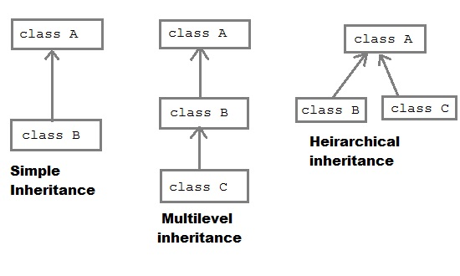
Types of Inheritance
Extending a class

Slide 6
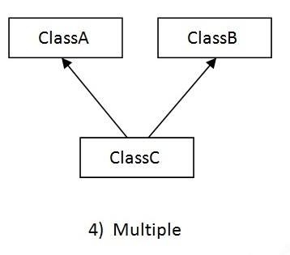
Types of Inheritance
Java does not support Multiple Inheritance
by extending a class.
Multiple inheritance can be achieved
using implementing a interface.
Interface A
Interface B
implements
extends

Slide 7
Using super keyword
Uses of super keyword
to refer immediate parent class member like.
instance variable
Method
constructor.

Slide 8
Bank
Bank
name : String
- name
+ showMe( )
+ showMe( ) : void
Customer
-name :<Bank>
-name :<Customer>
+ showMe( ) : <Bank>
+ showMe( ) : <Customer>
+ setMe ( String, String )
+ main()
Customer
name : String
+ setMe ( String, String ) : void
+ showMe ( ) : void
+ main() : void

Slide 9
Create Bank class
create instance variable called name of String type
Create method showMe () to display this name
Inherit class Customer from class Bank
Create instance variable name for customer
Customer ‘name’ Shadow the instance variable name of Bank class
Add method SetMe ( String, String) to set bank name & customer name.
Add method showMe () to display Customer name and call showMe() of super class.
call the methods of customer in main() method

Slide 10
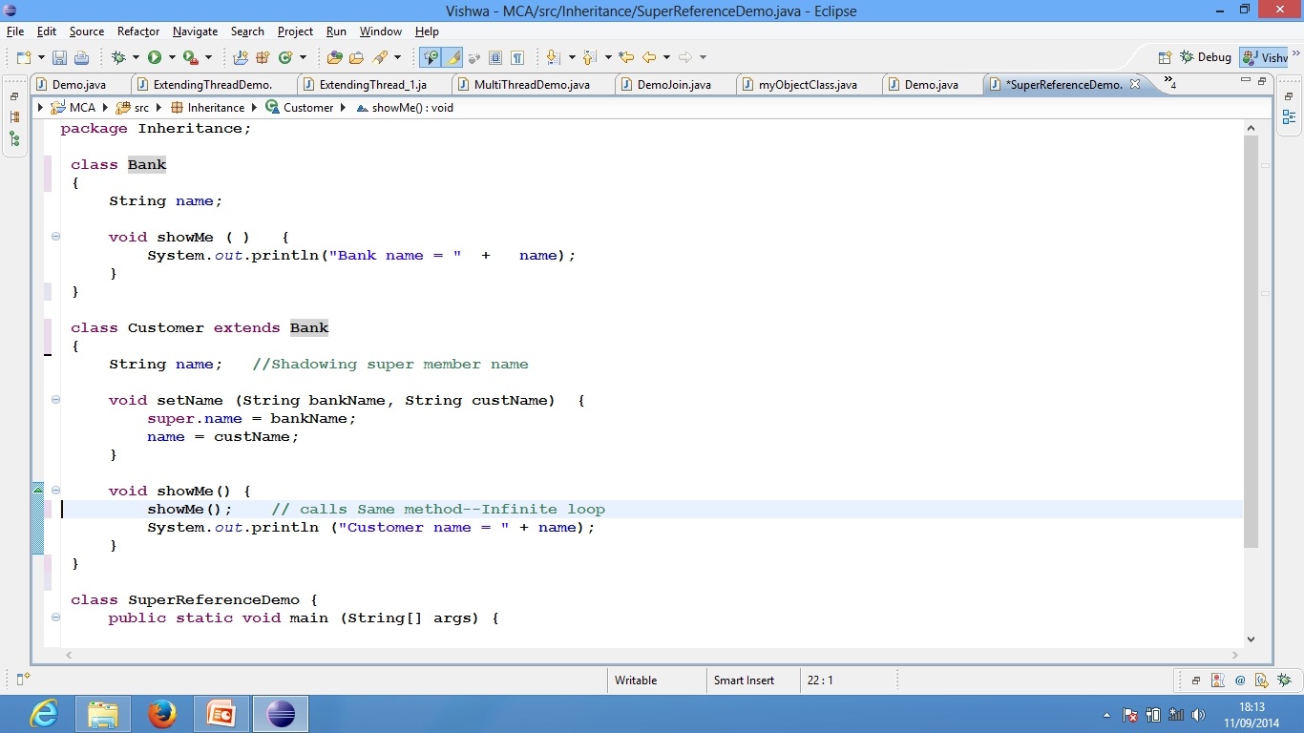
name = bankName ;

Slide 11
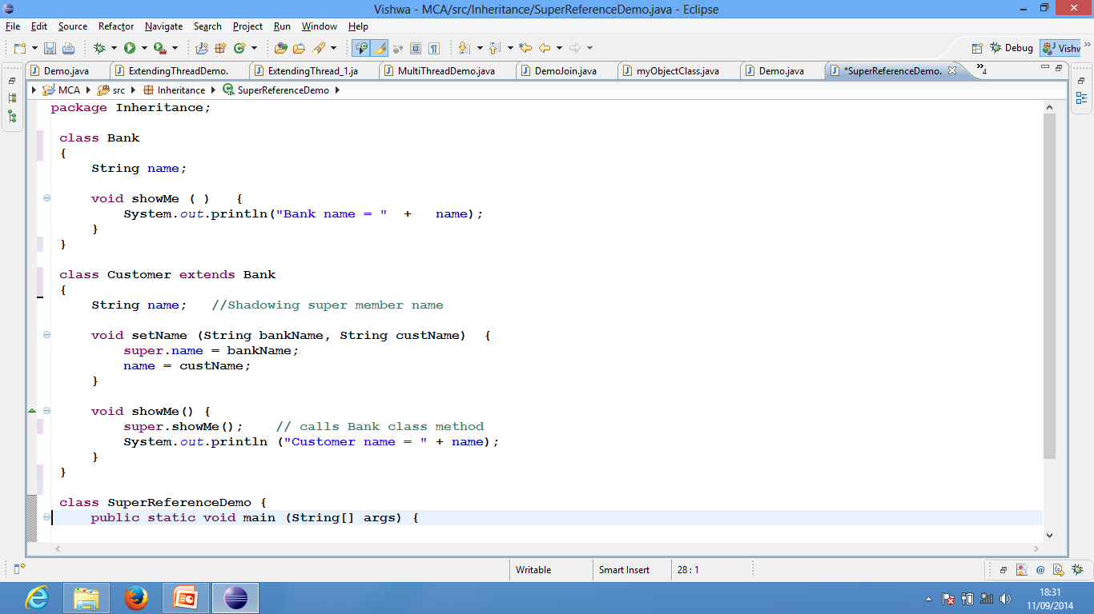
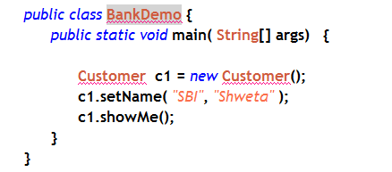
Output
Bank name = SBI
Customer name = Sweta

Slide 12
Super()
super( [parameters] )
Calls parent class constructor
Called from sub-class constructor
must always be 1st statement.

Slide 13
Create Bank class
Methods:
Default constructor - Display name to “ICIC Bank”
Parameterized constructor -
bankName is parameter.
Display bank name
class Customer inherits from Bank
Shadow instance variable: name (String)
methods
default constructor
Call super constructor
Set customer name “”
parameterized constructor -
Call super constructor by passing bank name
Set customer name
show() – display Bank Name and customer Name
Implement this in Demo class

Slide 14
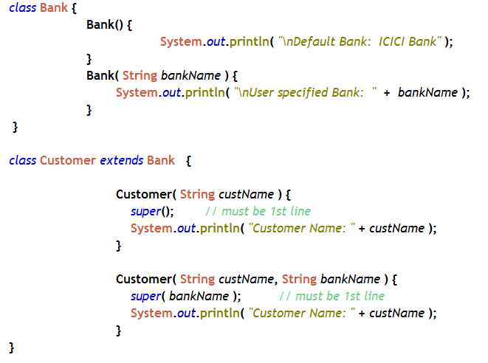
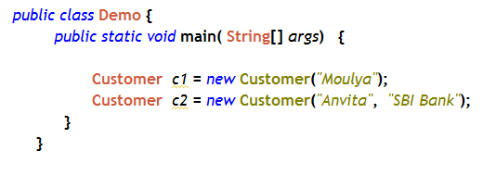

Slide 15
using super
To access shadowing variables of parent-class.
super.instance_var;
To call overridden methods of parent-class.
super.methodName();
To call constructor of parent-class.
Super(); // calls default constructor
Super(parameters); // calls parameterized constructor
Used in sub-class constructor
'super()' must always be 1st statement

Slide 16
Multilevel Inheritance
Order of constructor execution
Constructor of class-A
Constructor of class-B
Constructor of class-C
Write constructors to each and demonstrate

Slide 17
Multilevel Inheritance
class A {
A() {
System.out.println("Constructor of class A")
}
}
class B extends A {
B() {
System.out.println("Constructor of class B")
}
}
class C extends B {
C() {
System.out.println("Constructor of class C")
}
}
class Demo {
public static void main(String a[]) {
C ob = new C();
}
}

Slide 18
Multilevel Inheritance
Order of constructor execution
If super is not used in any constructor then
constructors are called in the order of derivation.
The default constructor of each super class will be executed first.
Subclass constructor is the last to execute.

Slide 19
Accessing private using accessor method
class A {
private int a;
A(int a) { this.a = a; }
public int getA( ) {return a;}
}
class B extends A {
B(int b) { super(b); }
public int getB( ) {return getA( ); }
}
`
int result = new B(10).getA();

Slide 20
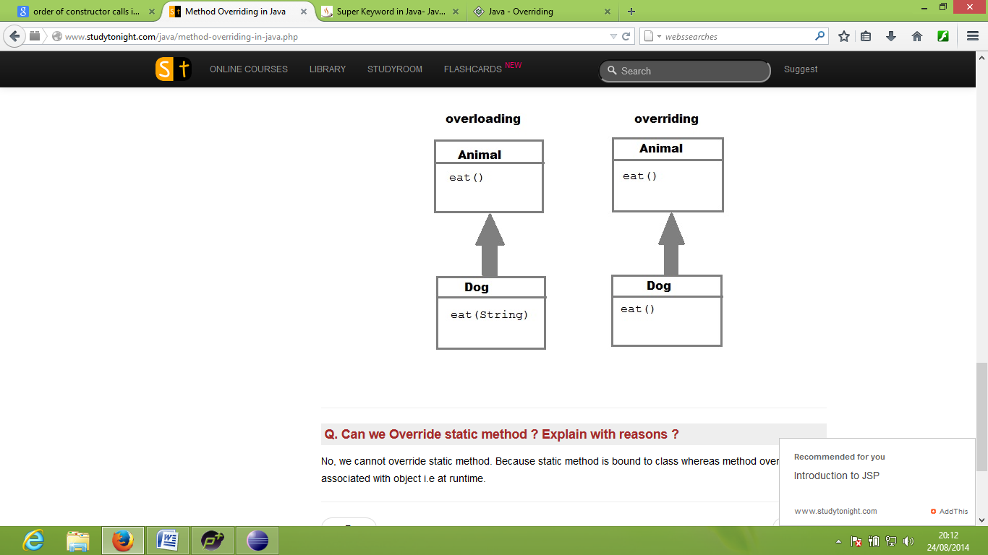
Method over-riding
Method over-riding :
Happens only with inheritance.
sub-class method and parent-class method must have
same name
Same parameter
Same return-type

Slide 21
Method overriding..
Restrictions for overriding
Instance methods can be overridden only if they are inherited by the subclass.
If method is private, static or final, it can not be overridden .
private method can not be overridden.
static method can not be overridden.
final method can not be overridden.
Constructors cannot be overridden.

Slide 22
Using super class reference

Slide 23
Using super class reference
Calling methods using single object
Animal
eat()
Dog
Snake
Man
eat()
eat()
eat()
Dog ob ; // Sub Class reference
ob = new Dog();
ob.eat();
ob = new Animal();
ob.eat();
ob = new Snake();
ob.eat();
// Can’t access super class
// Can’t access other class

Slide 24
Using super class reference
Implement the structure.
Animal
eat()
Dog
Snake
Man
eat()
eat()
eat()
Animal ob ; // SuperClass reference
ob = new Animal();
ob.eat();
ob = new Dog();
ob.eat();
ob = new Snake();
ob.eat();
ob = new Man();
ob.eat();
Dynamic method dispatch

Slide 25
Dynamic method dispatch
Dynamic method dispatch
Method overriding is a Means of run time polymorphism
Which method to call is based on current object type, at run time
In Dynamic method dispatch a call to an overridden method is resolved at run time, rather than compile time.
Method to execute is selected from the class to which the object is referring at run time.
Super-class reference is used to achieve Dynamic method dispatch
Animal
eat()
Dog
Man
eat()
eat()

Slide 26
Method overriding..
Method overloading Vs overriding

Slide 27
Method overloading Vs overriding
Overloading | Overriding
Static polymorphism | Runtime polymorphism
Same name different signature | Same name same signature
Return type can be same or different | Return type also should be same.
class A { int show ( ) { -- } void show( String s) { -- } } | class A { void show ( ) { -- } } class B extend A { void show ( ) { -- } }

Slide 28
Abstraction Basics
Abstraction
Abstract methods
Abstract classes
Final classes/ methods/ variables
Object class

Slide 29

Principles of OOPs (Object oriented Programming)
Abstraction
Hiding implementation details and showing only functionality.
Real-time Example: ATM
Abstraction in Java :
abstract method.
Abstract class.
interface.

Slide 30
Basics
What is a concrete method?
A method that has body is called concrete method
Example:
void show() {
System.out.println(“Hello”);
}

Slide 31
Basics
What is a abstract method?
A method that has No body and ends with semicolon
Example:
abstract void show() ;
Such a method must be declared with abstract keyword

Slide 32
Abstract methods and Abstract class
Two ways of achieving abstraction
Abstract class : contains abstract and non-abstract methods
Interfaces : contains only abstract methods and final variables

Slide 33
Abstract methods and Abstract class
Abstract class
If a class has any abstract methods, such class must be declared abstract.
An abstract class cannot be instantiated (we can’t create objects).
Example:
abstract class GraphicObject { //abstract class
void show () {
// non abstract method
}
abstract void draw(); //abstract method
}

Slide 34
Abstract methods and Abstract class
When abstract class is extended,
the sub-class must provide implementation for all abstract methods of abstract class ,
or sub-class must again be an abstract class.
abstract class can only be used as a super class.
An abstract class must have at least one abstract method.

Slide 35
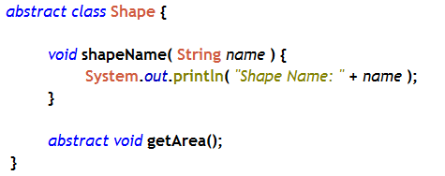
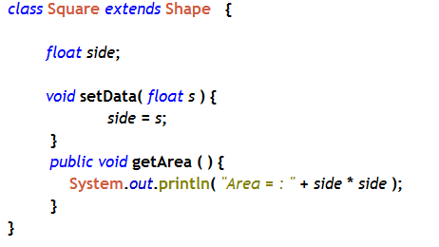
abstract method
Implementation of abstract method

Slide 36
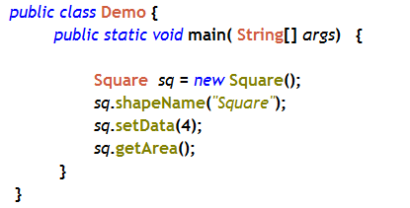
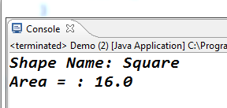

Slide 37
Abstract methods and Abstract class
More on Abstract class
Abstract classes are declared with the abstract keyword.
Abstract classes are used to declare common characteristics of subclasses.
Abstract classes are used to provide a template or design for concrete subclasses.
As we can’t create objects for abstract class. they must be subclassed,
When abstract class is extended, the sub-class must provide implementation for all abstract methods of abstract class , or sub-class must again be an abstract class.
abstract class can only be used as a super class.
An abstract class must have at least one abstract method.

Slide 38
Use of final keyword
Use of final
final class
final method
final variable

Slide 39
final class
Final class is created with keyword final
Restrict the inheritance: cannot be subclassed.
Creates immutable class.
Immutable classes can not be modified.
All methods in a final class are implicitly final.
String class is example of immutable and final class.
final class Student {
//code
}
class RNS extends Student { //Not allowed
//code
}

Slide 40
Final method
A final method cannot be overridden by subclasses.
Example:
class Shape {
final void showShape()
{
System.out.print(“This should not be hidden”);
}
}
class Rectangle extends Shape {
void showShape() //cannot be overridden
{
System.out.print(“Can’t be overridden ..”);
}
}

Slide 41
Final Variable
are constants that can-not be modified.
class RNS {
final int MAX = 20;
---
---
}

Slide 42
More on Final Variable
Non-static final variable
static final variable
final parameters

Slide 43
Final Variable
Non-static final variable can be initialized only once
either initialized with the declaration itself. or
must be Assigned in constructor
static final variable
must be initialized only with the declaration itself.
Can’t be assigned in constructor

Slide 44
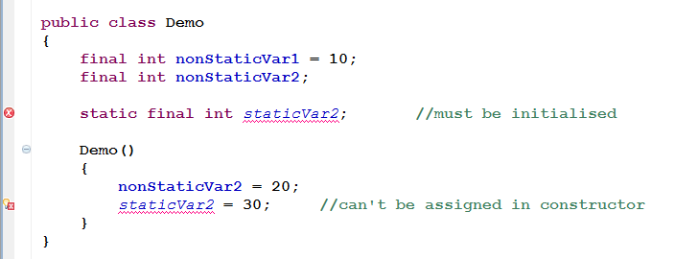
Final Variable
Example:

Slide 45
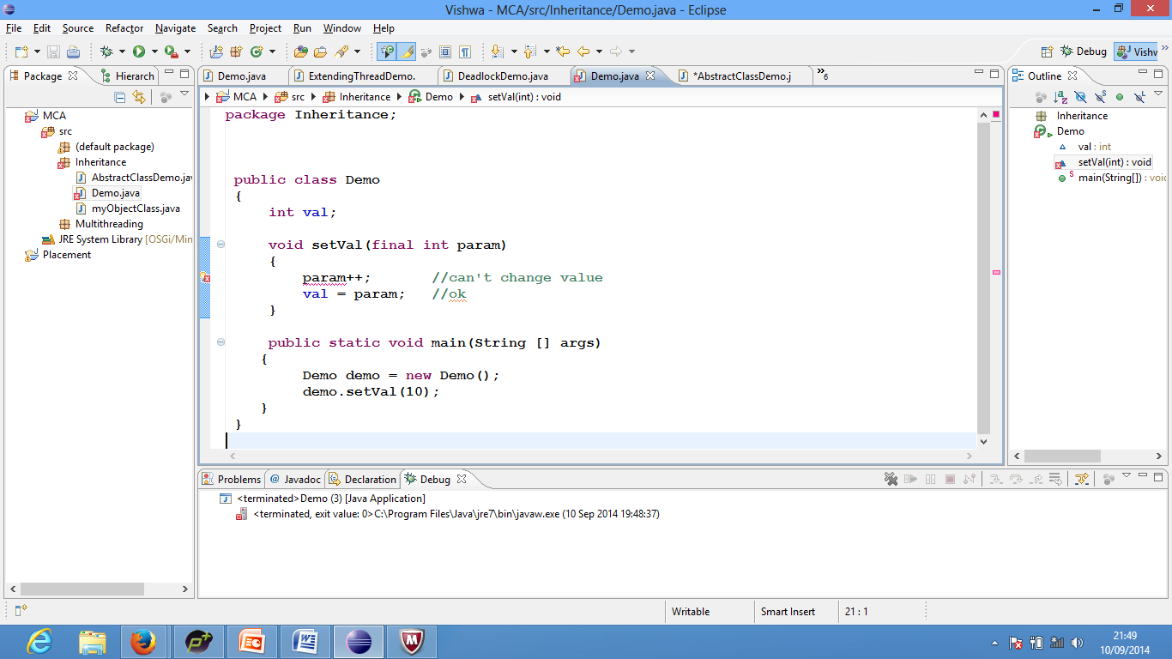
Final Variable
final parameters
Can’t be modified by the method.
Generally Used to copy values into instance variables
Example

Slide 46
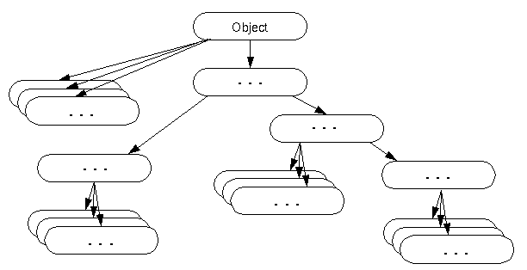
The object class
java.lang.Object class is the root of the class hierarchy.
Every class has Object as a superclass.
Every class you use or inherits the instance methods of Object class.

Slide 47
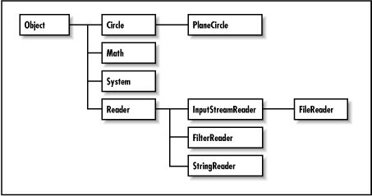
The object class
Consider you have a Super-class called Circle and Subclass called PlaneCircle then it can be viewed as shown below
Circle
PlaneCircle
Your class structure

Slide 48
Methods of The object class
Method | Description
public boolean equals (Object obj) | compares the given object to this object.
protected Object clone() throws CloneNotSupportedException | creates and returns the exact copy (clone) of this object.
public String toString () | returns the string representation of this object.
public final void notify () | wakes up single thread, waiting on this object's monitor.
public final void notifyAll () | wakes up all the threads, waiting on this object's monitor.

Slide 49
Methods of The object class
Method | Description
public final void wait (long timeout) throws InterruptedException | causes the current thread to wait for the specified milliseconds, until another thread notifies (invokes notify() or notifyAll() method).
public final void wait() throws InterruptedException | causes the current thread to wait, until another thread notifies (invokes notify() or notifyAll() method).
protected void finalize() throws Throwable | is invoked by the garbage collector before object is being garbage collected.

Slide 50
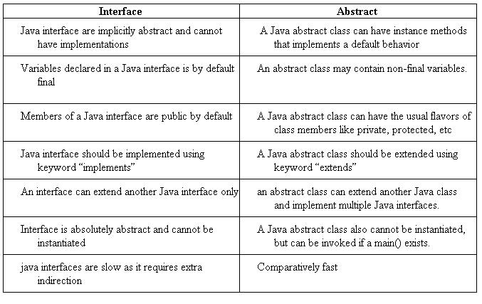
Difference between Interface & Abstract

Slide 51
Using super class reference
Why need superclass reference
Animal
eat()
Dog
Snake
Man
isPet()
wild()
eat()
Dog dog = new Dog();
dog.isPet();
Snake sn = new Snake();
sn.wild();
Man man = new Man();
man.eat();
Need many different references…

Slide 52
Using super class reference
Animal
With superclass reference
eat()
Problems with super reference
Dog
Snake
Man
isPet()
wild()
eat()
Animal animal ; // SuperClass reference
animal = new Animal();
animal.eat();
animal = new Dog();
animal.isPet();
animal = new Snake();
animal.wild();
animal = new Man();
animal.eat();
Super class reference can’t access subclass methods
// ERROR
Super class don’t know what subclass has extended.
// ERROR

Slide 53
Using super class reference
Animal
eat()
Dog
Snake
Man
eat()
eat()
eat()
Solution
use
method overriding
Dynamic method dispatch

